Slide 1


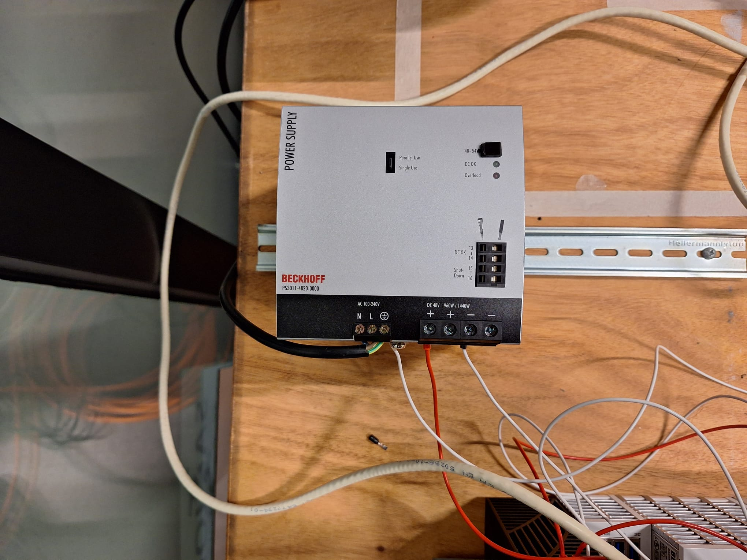
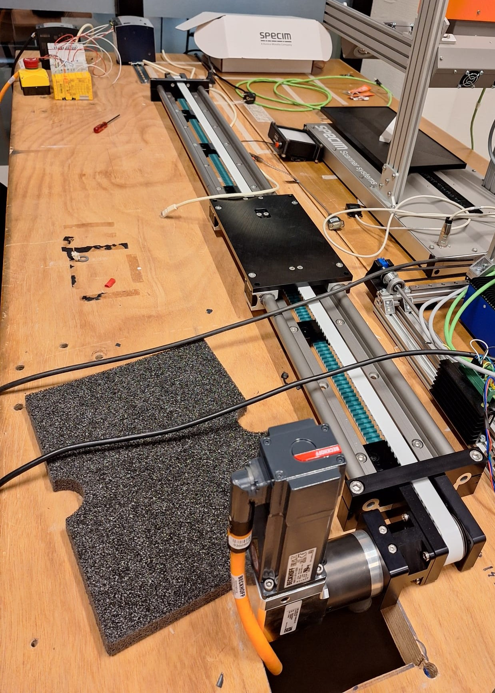
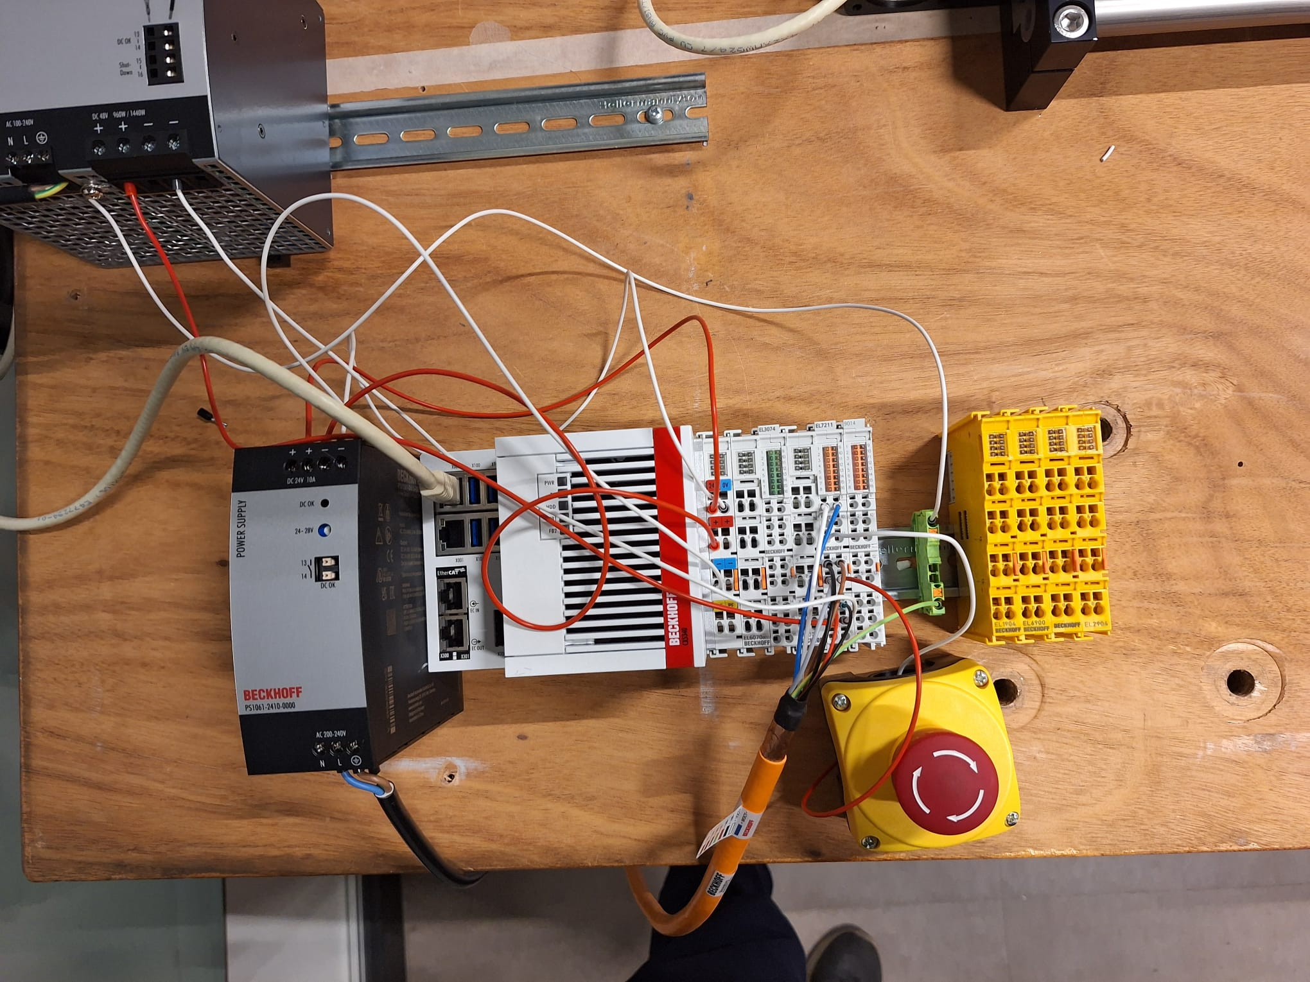
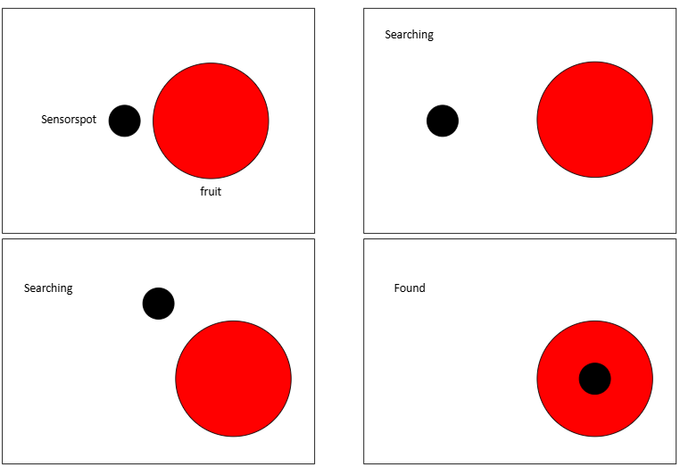
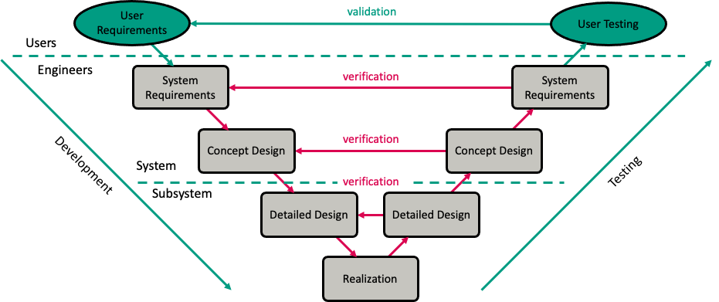
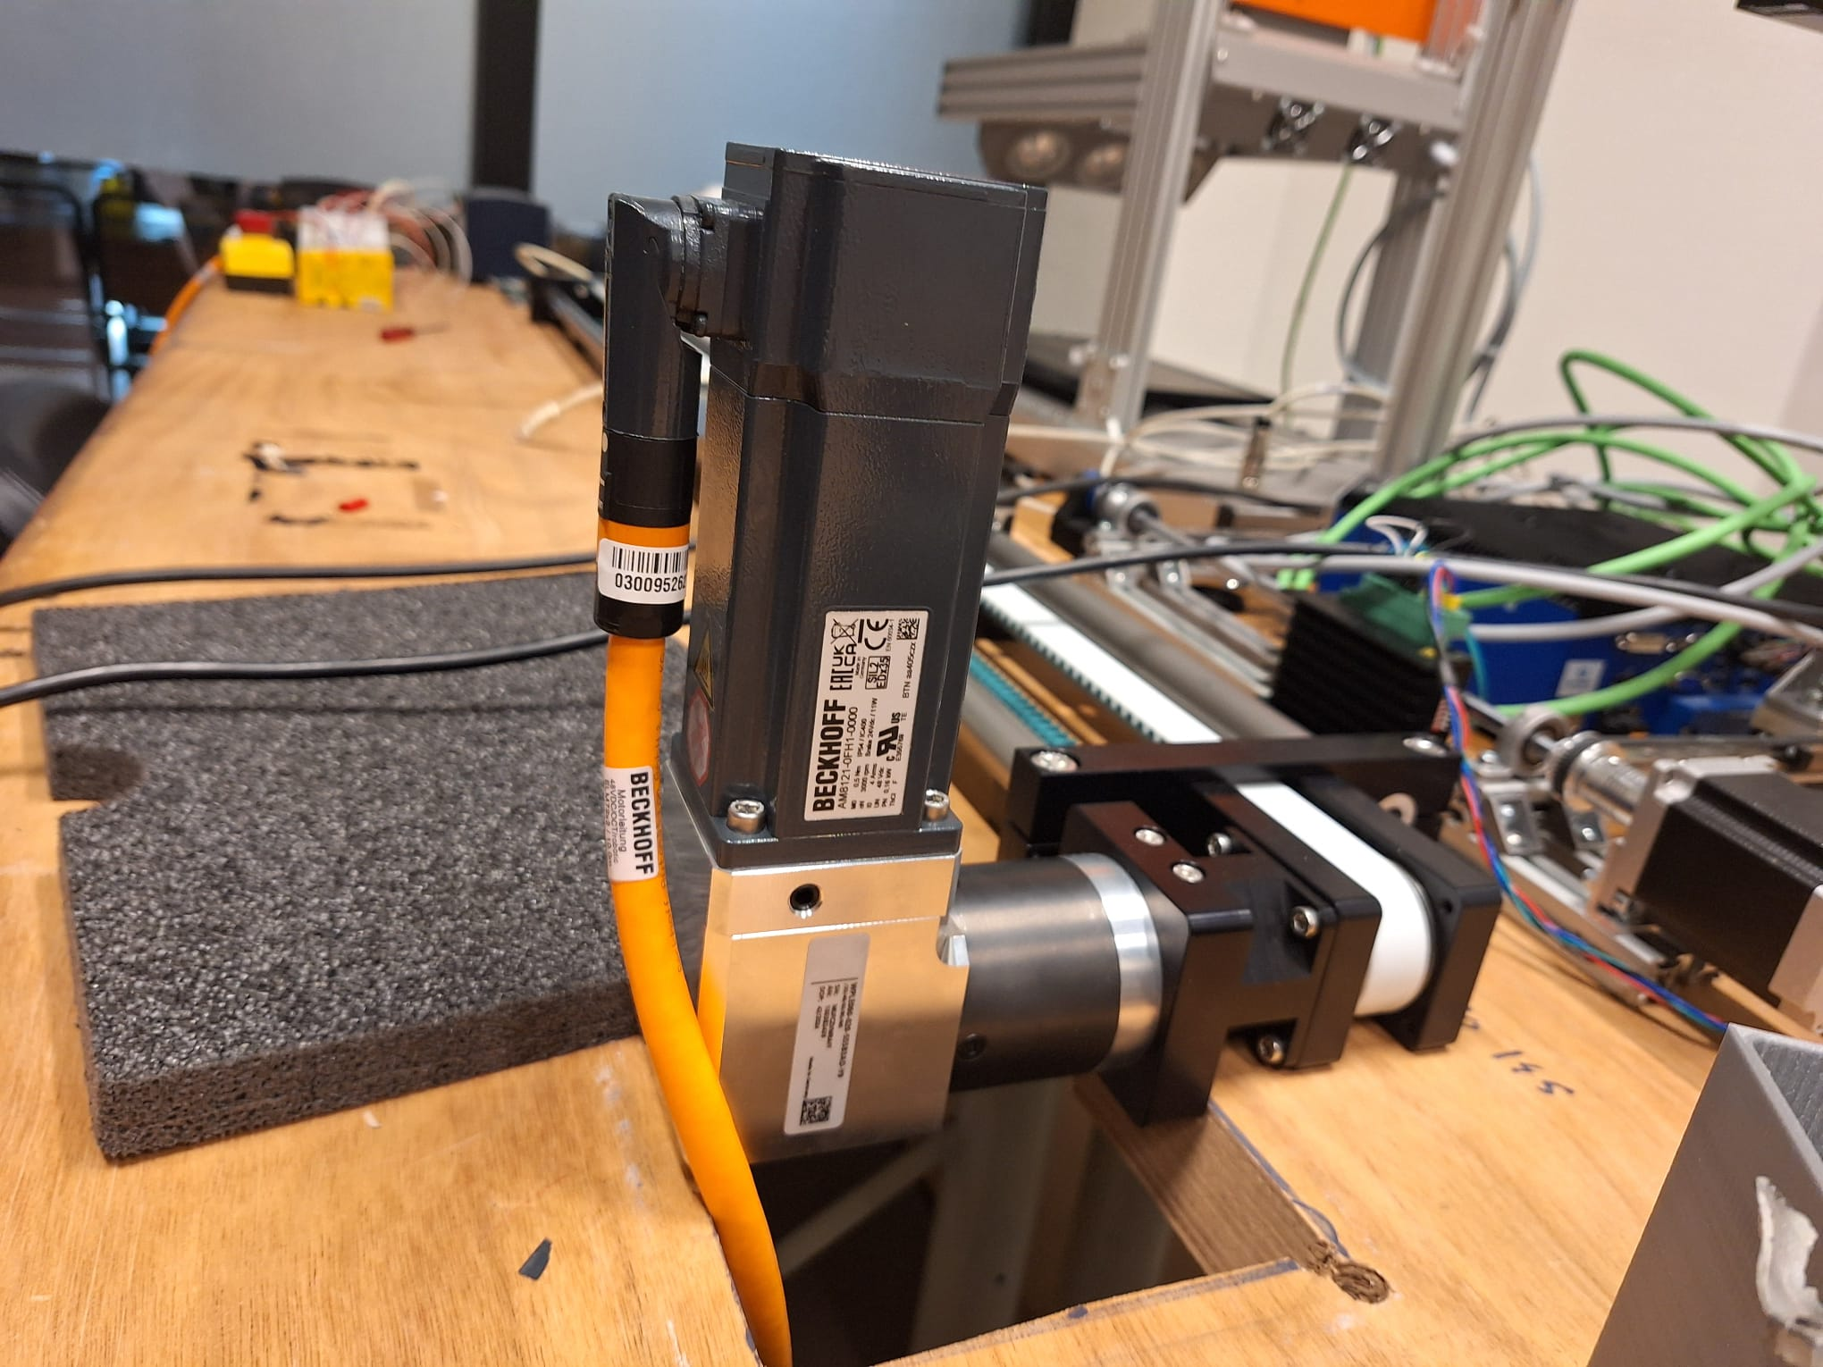
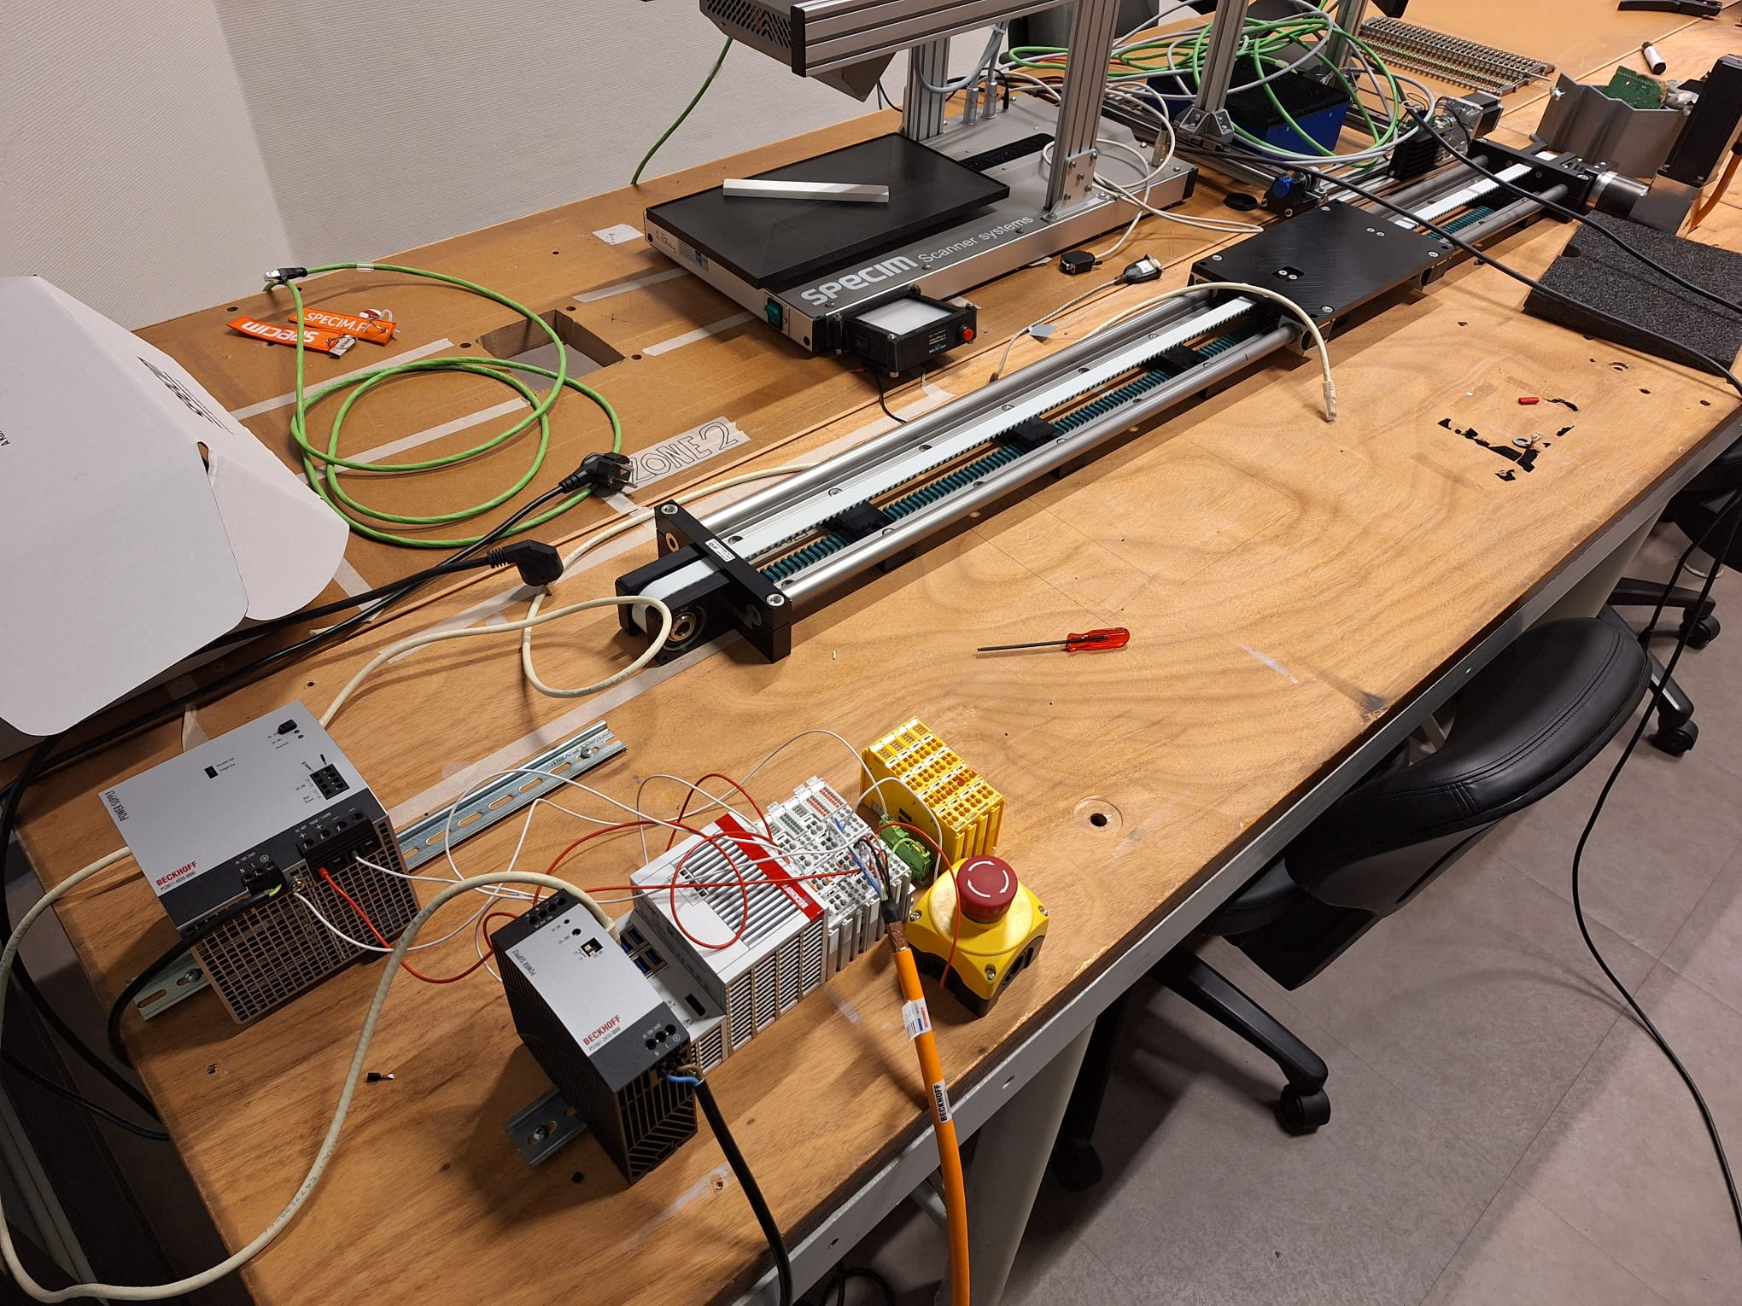
SCARA ARM ROBOT
Student team: Cesar Calleja,Herbert Smelt, Mersin Ali, Nhật Hà
Supervisors:Ard Westerveld
Introduction project / research
Experiments & results
In order to achieve optimal results in modern agriculture, smart harvesting robots are the key to improve efficiency, reduce manual labor and waste. Using computer vision and sensors, the harvester can ensure optimal harvesting quality.
The group is working on a fruit picking system that can detect the position and the ripeness of the fruit using a SCARA ARM Robot. Currently, we are working on designing the controller for all axis of the robot arm, researching sensors and looking for ways to implement these components.
What makes this project challenging is learning new technologies such as EtherCAT slave controller, TwinCAT Beckhoff platform, and real-time implementation.
Building hardware configuration setup for one axis of the robot.
Commissioning the movement of the Z-axis of the robot.
Control the EtherCAT motor drive from PLC/Master side
Real-time testing and implementation.
Supporting visualisations or data to show results, e.g.:
Methodology and approach
Challenges and questions
The organization of this project is stick to the V-model methodology.
The state of the group is currently Realisation where there's mainly commissioning and coding.
Mismatch between the actual gearbox ratio and the mapping gearbox ratio.
Mismatch in the PDO mapping led to the incorrect encoder feedback values.
Movement algorithms that help finding correct position of the fruit.
Supporting visualisations or data to request guidance / input, e.g.:
Figure 1: Project approach with V-model methodology
Timeline and progress
Visual timeline with progress indicators - where are you in your research phase?
Initial research
Development
Integration
Testing
Discussions and next steps
Phase | Timeline | Status | Key achievements
initial research | Sept 1st – October 8th | ✓ complete | Defined concept, set goals, selected sensor options
Development | October 8th-November 28th | 🔄 in progress | Hardware setup, PLC Link, programming
Integration | Dec 1st – Dec 20th | ⏳ upcoming | Sensor-motion connection
Testing | Jan 1st – Jan 26th | ⏳ upcoming | Final demo and validation
Insert correct PDO mapping and correct gearbox ratio.
Synchronize all axis of the robot.
Integrate sensors to both Software and Hardware.
More information can be found on our website:
Acknowledgements
https://www.saxion.nl/onderzoek/lectoraten/smart-mechatronics-and-robotics

